Slide 1
Open Science Survey

Slide 2
Issues Preventing Progress What are the biggest impediments to science/model/application improvements that a more open process could address?
No standardization for data/model outputs (3.5)
Lack of incentives (funding/recognition)for providing usable, documented opensource code/data/resources (3.5)
Lack of access to data (4)
Lack of access to models/model output (4)
Lack of access to model/analysis code (i.e github) (4)
Limited engagement with end-users (4.5)
Limited availability of impact data (6)
No standardized archives of model output (6)

Slide 3
Issues Preventing Progress Community Suggested Ideas
Additional Use Case Documentation/Descriptions
Lack of model application examples
Recognition of analysis or modeling caveats - what are the difficulties in using a mode or data set?
Handbook of model descriptions and examples of outputs would be useful as number of models increases
End-to-end accounting of uncertainties and gaps of data/knowledge
There is not a readily available way for researchers to reach end-users. Some kind of point-of-contact database/webpage would be valuable for connecting people and connecting models.
More initiative/call for global collaborative research (specially call for early career scientists)

Slide 4
Standards How can the community develop/adopt a set of model/data/code standards and ensure their widespread use?
Create a single site with documents and standards definition that would also allow users to suggest/add updates (2)
Standards are not always suitable and so aren’t used. Allow open input from modelers and data providers on standards that make sense to encourage their use. (3)
Develop/provide open access to common tools for creating and validating metadata (3)
Create metadata that captures model boundary conditions and parameters (3)
Require training on standards (5)
The satellite industry has discussed giving Sustainability Grades to encourage responsible use of space instead of forced regulations. Similar usability grades could be given to models or datasets to encourage use of standards etc. (5)

Slide 5
Incentives
Create additional budget incentives to make data/models open, available, and well documented. For example, an additional percentage of funding could be available to proposers to make data or code openly available (1)
Required Open Science 101 type training/education on what open science is, how to implement it, and the value of open science/data/models (example https://openscience101.org/)(2)
Provide open metrics on model usage at CCMC that could be used to highlight the importance of a particular model for future funding (2.5)

Slide 6
Incentives Community Ideas
Maintenance/support funding:
Funding for code developers to provide user support to the public when questions are asked or bugs are encountered?
I don't think the first idea is going to work, and will easily be politicized. Most are unaware of the benefits of most modeling efforts, and what they need in addition to what they already have. I think if some way could be found to learn the benefits and problem areas each model faces, this would benefit both the model, and those who are able to input. Perhaps funding can be found for those who help other modeling efforts.
Optimization funding:
Fund efforts aimed at optimizing existing CPU-intense models to further incentivize their interactive use by end users
Prioritize funding for Open CCMC code:
Prioritize well-documented, tested, and published CCMC models over similar class models in NASA funding opportunities. Incentivize the proposers to work with CCMC and model developers on their projects rather than pursue simulations with their own models. Proposers should well justify their decision to run their models over similar CCMC models. For instance, they may say: "We need a simulation feature than is not currently available at CCMC and CCMC model developers cannot implement it at this time".
Fund efforts that generate a variety of "ready-to-use" model applications ("setups") with significant science impacts, which end users would be interested and willing to explore on their own. Examples could include global Earth and planetary/cometary/lunar setups, local setups (e.g., shock and turbulence studies), laboratory astrophysics setups, etc

Slide 7
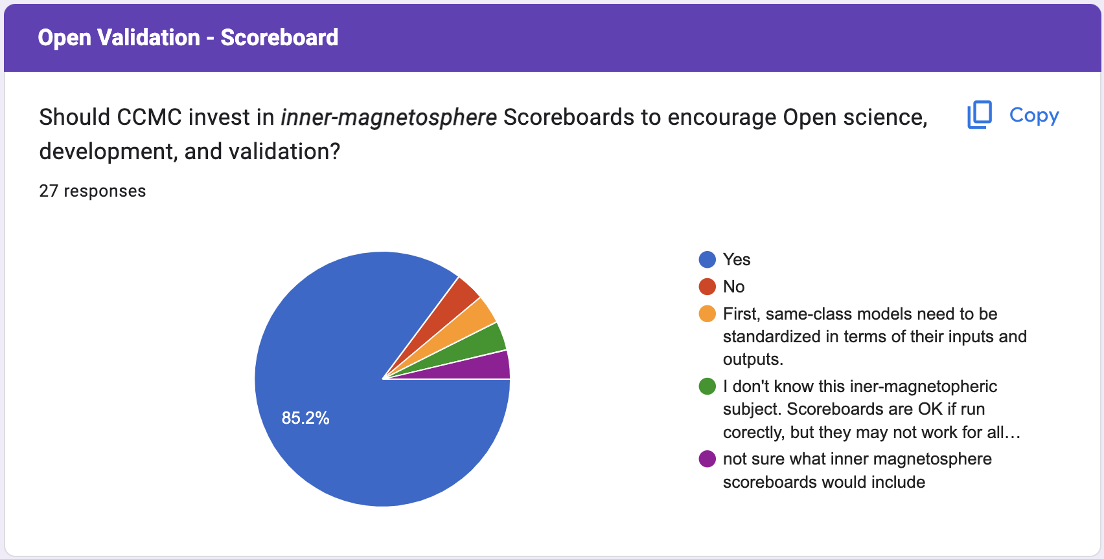
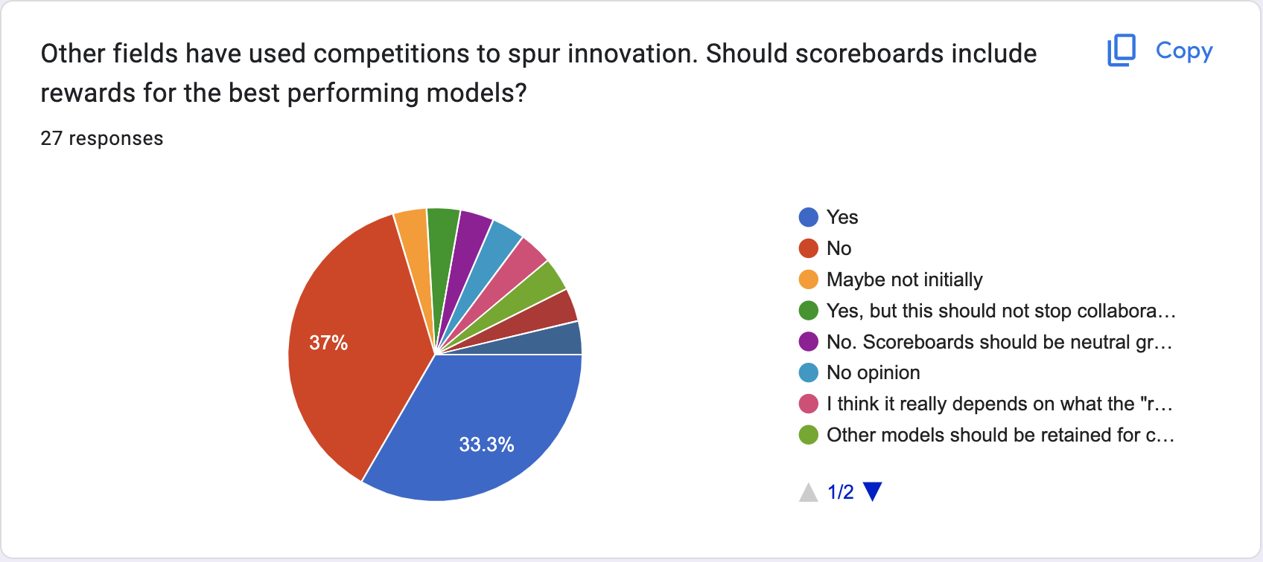
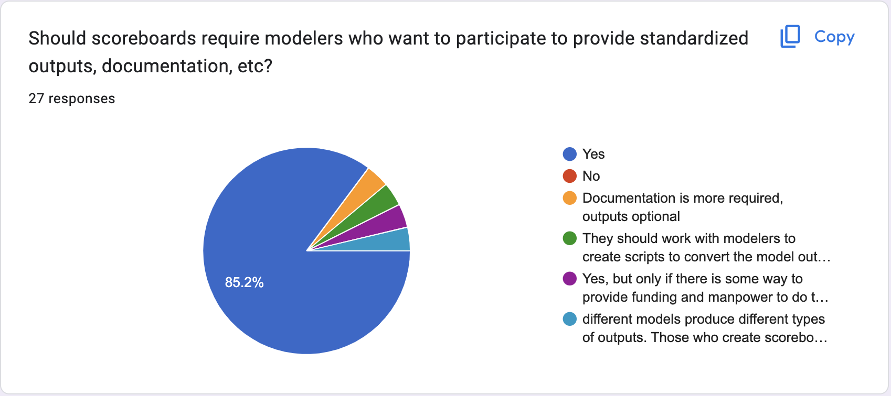
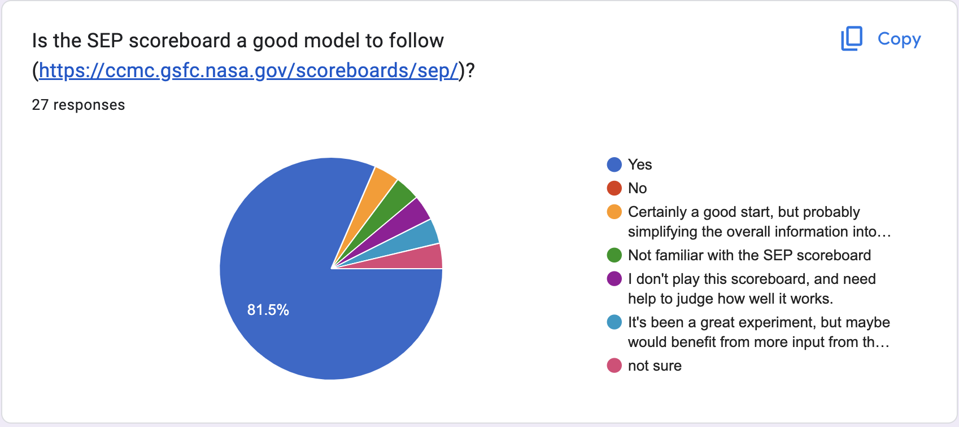

Slide 8
Inner Magnetosphere Scoreboard What should be the focus?
Impact focused
Quantities that can be easily translated to the corresponding impacts
How well the models reproduce the behavior of the environment and/or the response of a spacecraft to such environment
Charging hazard proxies
Particle fluxes
Ion (different species) and electron trapped and precipitation particle fluxes, plasmaspheric density and their accuracies with respect to observed data in different geomagnetic conditions
If feasible at all, the focus should be on matching available observations.
energetic particle fluxes
ring current? (e.g. Dst forecasts?)

Slide 9
Open development: User Involvement How do we encourage active end user engagement in the application development process and open contributions to that process (such as user needs and impact data)?
Allow end users to set the funding goals for specific calls
Forum/Message board for user suggestions and interactions with developers
Have a suggestions message board?
(1) Create forum-like websites where users can post their suggestions and problems in using the models. The model developers can interact with the users on these websites. (2) Provide some funding that supports these websites.
I think a community forum is great for the communication between model users and model developers. And we should ensure that there are funds available to model developers for them to actively contribute to the forum, answer the users' questions and improve their models based on the users' need.
Focused meetings/workshops that include different communities
start with SEESAW, ASEC type meetings that have attendees from different communities (research, modelers, end users, ..)
A lot of this requires personal and honest interaction among groups. Conferences may be one way to do this, but not best. Personal interactions are better, so perhaps inviting modelers and end users together on a very specific topic of intest to both would be a better way to get things done. I have a very good example here from my recent trip to CSIRO Australia last week.
Need to identify end users and actively recruit them to participate in the process. This may involve reaching across fields. Recommend a workshop-like forum to pull in interested parties and then one-on-one participation in relevant model development teams.
Explicit Funding and Requirements
Adequate funding is critical. This must include funding to support maintainance of models. Imposing open sourcing through grants would seem a mistake to me (unless NASA pays for model development from the start). Create programs that pair model development to users. Create programs to develop a skilled workforce in computational space physics
Encourage and fund the academic side of the community to contribute and develop with end users.
In the cases where the model developers are not their own end users, funding and directives from management. In my limited experience, people responsible for operational systems do not have the mandate, time, interest, or money to support models that are (per the question) still in development
The only way to do it is through explicit requirements in FOAs (see my earlier response). Either proposers convincingly demonstrate the superiority and usefulness of their own models OR they should use (and contribute) to appropriate CCMC models.

Slide 10
Open development: User Involvement
Surveys/Polls from CCMC about user experience
Contact model users for feedback when new model versions are released on CCMC. 2. Send periodic polls to model users on CCMC to ask for feedback as to which capability they seek, report bugs, report/suggest which physics could be improved in the model. Make sure that the model addresses community needs and its development is driven by the changing landscape of scientific inquiry.
Ask all users to send in a brief report on their experience and to provide suggestions for user interactions and interfaces
Document user contributions in the model webpage, acknowledgement to them in published papers and if the contribution is significant, providing co-authorship

